Slide 1
Module 11
Product Decisions
By: Dr Shahinaz Abdellatif

Slide 2
Objectives of the Session
1. To understand the product concept
2. To understand the concept of branding
3. To understand the stage gate system for new product development

Slide 3
Objectives of the Session
Questions that marketers face in differentiating their offerings from those of their competitors. How should our product offering, whether a good or a service, be designed to give it a chance to win sustainable competitive advantage?
What product decisions must we make to deliver the benefits and value promised in our positioning statement or value proposition?
How can products and product lines best be managed to satisfy the needs of different market segments, rather than simply taking market share from the firm’s other products?
Finally, given the importance of new products in the long-term success of most firms, how can new product development be managed, from a process perspective, to ensure a timely flow of new products that enjoy favourable reception by customers?

Slide 4
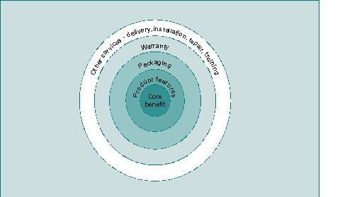
The Product Concept

Slide 5
What is a product?
A product can be defined as anything that satisfies a want or need through use, consumption, or acquisition. Thus, products include :
objects (TVs, radios, cars),
services (medical, educational),
places (New York, Moscow),
people (Tony Blair and other politicians everywhere),
activities (entering a contest or visiting aweight-loss
clinic), and
ideas

Slide 6
Features versus benefits
Features are the tangible or intangible attributes given the product by its designers.
Benefits are the solutions to customer problems or needs delivered by the product.

Slide 7
What is a product?
3 levels of product
  Core product or benefit
  Tangible product
    Product features
    Packaging
  Augmented product
    Warranty
    Other services eg delivery, installation
    And intangible associations such as image

Slide 8
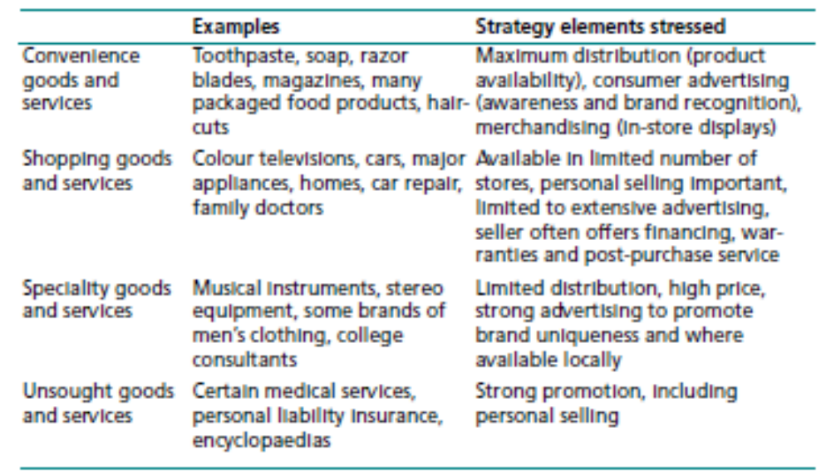
What is a Product?

Slide 9
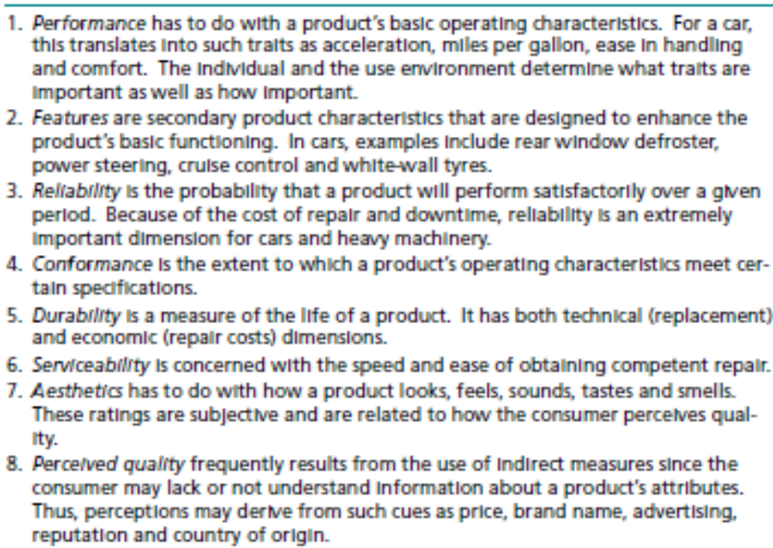
Eight dimensions of quality for goods

Slide 10
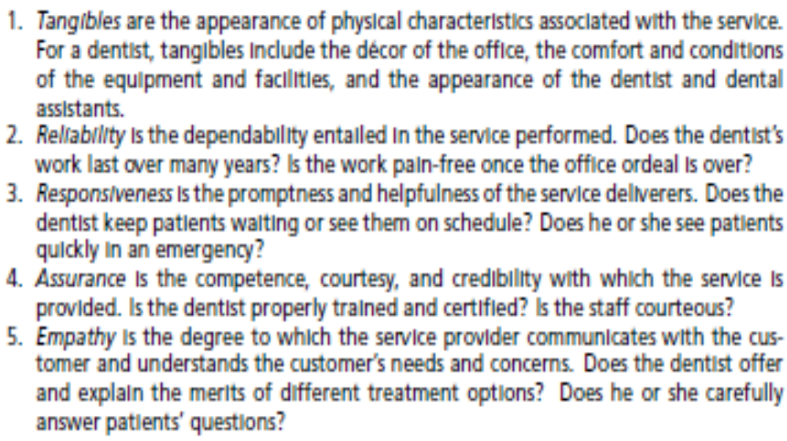
Five dimensions of service quality

Slide 11
Product Line & Product Mix
Product Mix:
the group of products sold by a company, e.g. all of the products sold by Heinz (soups, baby foods, beans, etc.)
Product Line:
a group of broadly similar products in terms of function, e.g. Ford’s line of car models

Slide 12
Branding Strategies
Individual branding requires the company to provide each product with a distinctive name. This type of branding is practiced by such firms as Procter&Gamble (Tide and Ariel detergents, Crest toothpaste), and Accor hotels (Mercure, Novotel, Motel 6).

Slide 13
Branding Strategies
Family branding uses the same brand name to cover a group of products. There are several variations of family branding including its use primarily with related items (Campbell’s soups and Dyson’s vacuum cleaners), its use with all company items regardless of whether they are use-related (General Electric is an example), and the use of a family name combined with individual product names (Kellogg’s Raisin Bran cereal).
The major arguments for using family branding are reduced costs and transfer of customer satisfaction from one product to another bearing the same name. The latter makes it easier to launch product modifications such as new package sizes.

Slide 14
Branding Strategies
Co-branding uses multiple brand names with a single product or service offering. To be successful, the new product should either open another segment or add value in existing segments.
Globalization; building a global brand is often difficult for a variety of reasons: the meaning of the brand name evoking negative associations in some countries; the presence of strong local brands; and the heavy investments required. Still, if successful, the scale effects can dramatically enhance sales and profits. The most successful global brands include Coca-Cola, Kellogg’s, Nike, Starbucks, McDonald’s, Kodak, Marlboro, IBM, American Express, Sony, Mercedes-Benz, and Nescafe

Slide 15
Product Line & Product Mix
Product Mix:
the group of products sold by a company, e.g. all of the products sold by Heinz (soups, baby foods, beans, etc.)
Product Line:
a group of broadly similar products in terms of function, e.g. Ford’s line of car models

Slide 16
Product Line & Product Mix
Line filling: This strategy lengthens the product line by adding items or features within the present range. Its objective is to satisfy more customers, to increase sales and profits, to placate dealers who want a full-line supplier, and to ward off competitors. e.g. Mercedes
Line Stretching: This strategy involves lengthening the product line beyond its current range of variables, such as size and price. e.g. Aircraft manufacturers, such as Boeing.
Line Extensions: This strategy consists of introducing new products that differ significantly from those in the existing line by more than just size and price.

Slide 17
Eight Dimensions of product/service quality
Performance
Features
Reliability
Conformance
Durability
Serviceability
Aesthetics
Perceived Quality

Slide 18
Difference between a Product and a Brand
A product is something with merely a functional purpose
A brand is a product that provides functional benefits plus added values that some consumers value enough to buy

Slide 19

Managing the NPD Process:
The Stage-Gate System
Detailed
Investigation
(Business Case)
Preparation
Preliminary
Assessment
Idea
Gate
1
Gate
2
Gate
3
Stage
1
Stage
2
Initial
Screen
Second
Screen
Decision on
Business Case
Notes:
See next slide

Slide 20

Managing the NPD Process:
The Stage-Gate System
Full
Production
& Market
Launch
Testing &
Validation
Development
Gate
4
Gate
5
Stage
3
Stage
4
Stage
5
Post-
Development
Review
Pre-
Commercialization
Business Analysis
Post-
Launch
Review
Notes:
Looks bureaucratic: what’s the rationale?
The point of the stage-gate system is to “kill” ideas that lack strategic or market potential early in the process, before significant resources are spent on these ideas, as well as to pave the way for high-potential ideas so that they not only get to market quickly but also have the “right” attributes to enhance their likelihood of market success.
Should all new products pass through the stages and gates in the same way?
Products really new to the company should pass through all stages and gate.s
Product modifications or line extensions may follow an expedited or compressed path to shorten their time to market, given the reduced uncertainty they entail.
Should all companies use the same number of stages and gates?
No, the number of stages and gates varies across companies, but the principles remain largely constant.

Slide 21
Looks bureaucratic: what’s the rationale?
The point of the stage-gate system is to “kill” ideas that lack strategic or market potential early in the process, before significant resources are spent on these ideas, as well as to pave the way for high-potential ideas so that they not only get to market quickly but also have the “right” attributes to enhance their likelihood of market success.
Should all new products pass through the stages and gates in the same way?
Products really new to the company should pass through all stages and gates
Product modifications or line extensions may follow an expedited or compressed path to shorten their time to market, given the reduced uncertainty they entail.
Should all companies use the same number of stages and gates?
No, the number of stages and gates varies across companies, but the principles remain largely constant.

